Slide 1


HIVE AVATAR
READY
AI Avatar for Academic
Advising using Fine-Tuned LLM
Hive Avatar: E-Bee Advisor
Jet Saw Jun Jie
Faculty of Artificial Intelligence and Engineering (FAIE)
Multimedia University (MMU)

Slide 2
THE PROBLEM
THE PROBLEM
Every semester, the same issue happens.
Long queues of students waiting for academic advising
Most cases are enrolment issues and subject eligibility
Students repeatedly ask simple questions like:
"If my credit hours is X, can I take this subject?"
Advisors spend time answering repetitive queries
Result: Delays, frustration, and inefficient use of academic resources
Long Waiting Queues

Slide 3
THE SOLUTION
THE SOLUTION
We built an AI-powered academic advisor with an interactive avatar.
Provides instant answers to academic questions
Understands course structure and prerequisites
Available anytime — no more waiting
Supports both voice and text interaction
Goal: Reduce workload and improve student experience

Slide 4
KEY FEATURES
KEY FEATURES
AI Avatar Interaction
Course & Prerequisite Guidance
Voice + Text Modes
Interactive 3D avatar interface that engages students with a friendly, approachable personality.
Comprehensive knowledge of course structures, prerequisites, and academic requirements.
Flexible input methods — speak naturally or type questions for instant responses.
Multi-Language Support
Domain-Specific Knowledge
Supports both English and Malay (Bahasa Malaysia) for diverse student populations.
Fine-tuned on academic data for accurate, programme-specific advising.

Slide 5
CORE TECHNOLOGY
CORE TECHNOLOGY
The system combines two key components:
Fine-Tuned Large Language Model
Retrieval-Augmented Generation (RAG)
Qwen3.5 2B trained on academic data
Specialized for Intelligent Robotics programme
Optimized for academic advising scenarios
Retrieves real data from SOP and course database
Ensures accurate and reliable responses
Reduces hallucination in generated answers
Result: Smart + factual answers powered by fine-tuned AI + real academic data

Slide 6
SYSTEM FLOW
SYSTEM FLOW
User Input
Speech-to-Text
Fine-Tuned Model
RAG Retrieval
Response Gen
Text-to-Speech
Avatar Output
Voice Mode: Full pipeline | Text Mode: Bypasses STT and TTS steps
Hybrid AI Architecture
The system combines AI reasoning (fine-tuned LLM) with real data retrieval (RAG) to produce responses that are both intelligent and factually grounded.
This hybrid approach ensures students receive accurate academic guidance based on official university documents.

Slide 7
RESULTS
RESULTS
97%
700+
EN + BM
< 2s
Accuracy on evaluation dataset
Academic Q&A handled
Multi-language support
Real-time interaction
Key Insight
Fine-tuning + RAG significantly improves reliability over base models. The combination of domain-specific training and real-time data retrieval ensures responses are both contextually appropriate and factually accurate.

Slide 8
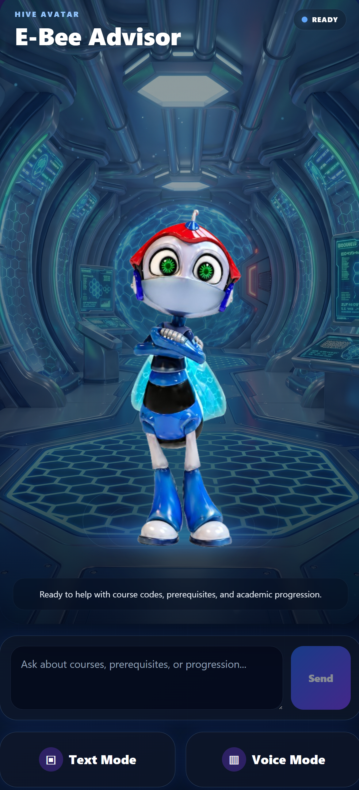
PRODUCT DEMO
PRODUCT DEMO
"A Virtual Academic Advisor"
Interactive AI avatar interface with 3D character
Text mode for typed queries
Voice mode for hands-free interaction
Real-time response system
Student-friendly dark theme design
Positioned as "A virtual academic advisor" — always available to help students with course-related questions.

Slide 9
WHY THIS MATTERS
WHY THIS MATTERS
Solves Real University Problems
Also Useful For
Open Day / Orientation
Helps students explore programmes
Reduces long queues during enrolment
Automates repetitive academic questions
Course Structure Guide
Explains prerequisites and pathways
Frees up lecturers for complex advising
Improves student decision-making
Interactive Campus Guide
Acts as an interactive guide for visitors
This system doesn't just answer questions — it transforms how students interact with academic services, making information accessible 24/7 and empowering better academic decisions.

Slide 10
FUTURE & SCALABILITY
FUTURE & SCALABILITY
Expand to Multiple Programmes
Integrate with University Systems
Extend beyond Intelligent Robotics to cover all faculties and programmes at the university.
Connect with LMS, student portal, and enrolment systems for seamless data access.
Deploy as Kiosks or Mobile Apps
Scale Across Institutions
Physical kiosks on campus and mobile applications for on-the-go access.
Adaptable framework for deployment at other universities and colleges.
VISION
AI-powered advising for every university

Slide 11
Thank You
This project transforms academic advising:
From long queues → instant answers
From repetitive workload → automated system
From limited access → always available AI
"Instead of students waiting in line, the advisor is now always available."
Jet Saw Jun Jie
Faculty of Artificial Intelligence and Engineering (FAIE)
Multimedia University (MMU)

